Slide 1
Lab meeting 05/08/2019
Mitotracker staining
immunoprecipitation

Slide 2
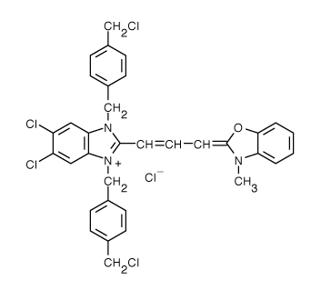
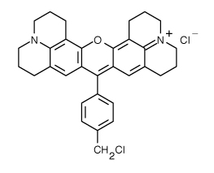
MITOTRACKER STAINING
N2A
Mitotracker™ Red CMXRos
Mitotracker™ Green FM
Dependent of ΔΨm
Independent of ΔΨm
Mitochondrial function
Mitochondrial mass

Slide 3
MITOTRACKER STAINING: Experiments 1 & 2
N2A
miR7 induces an increase in mitochondrial mass.

Slide 4
MITOTRACKER STAINING: Experiment 3
N2A
The increased accumulation of MTK Red in mitochondria is not proportional to that of MTK Green

Slide 5
MITOTRACKER STAINING: Experiments 3 & 4
N2A
I.
II.
miR7 induces an increase in mitochondrial mass...
… but ΔΨm is affected.

Slide 6

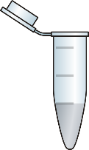
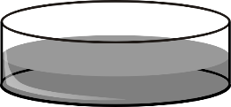
IMMUNOPRECIPITATION
N2A
Preclearing
+
WCE
α-hnRNPK
Tuning experimental conditions:
Protein purification & quantity
Ab quantity and company
Crosslinking
Elution method
Harsh (Vj’s lysis buffer + BB + 95ºC)
Gentle (Glycine pH 2’5)
X

Slide 7

IMMUNOPRECIPITATION
N2A
With our current conditions (500μg of total protein, 10μg of primary antibody), we can only precipitate a fraction of hnRNPK protein.
IP: scbt
WB: cs
IP: cs
WB: scbt
Std
Std
150 kD
100 kD
INSR
Insulin receptor (INSR) co-precipitates with hnRNPK.
75 kD
hnRNPK
50 kD
Testing right now:
1000 μg of protein
12 μg of Ab
≠ disposition in gel
IP
Input
IP
Input
SN
SN

Slide 8
Conclusions & Future experiments
N2A
Mitotracker staining
miR7 increases mitochondrial mass, but mitochondrial function seems to be impaired.
In line with what we see in Seahorse assays.
To-do list:
Repeat experiments in SH-SY5Y cell line.
mtDNA expression
Electron microscopy
Inmunoprecipitation
INSR co-inmunoprecipitates with hnRNPK.
To-do list:
Further tuning of experimental conditions
Evaluate effect of insulin and determine treatment time
Analyze co-IP of more proteins, such as GSK3β

